Slide 1

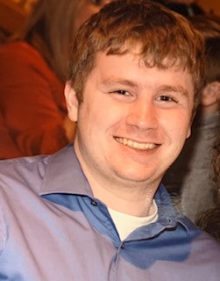

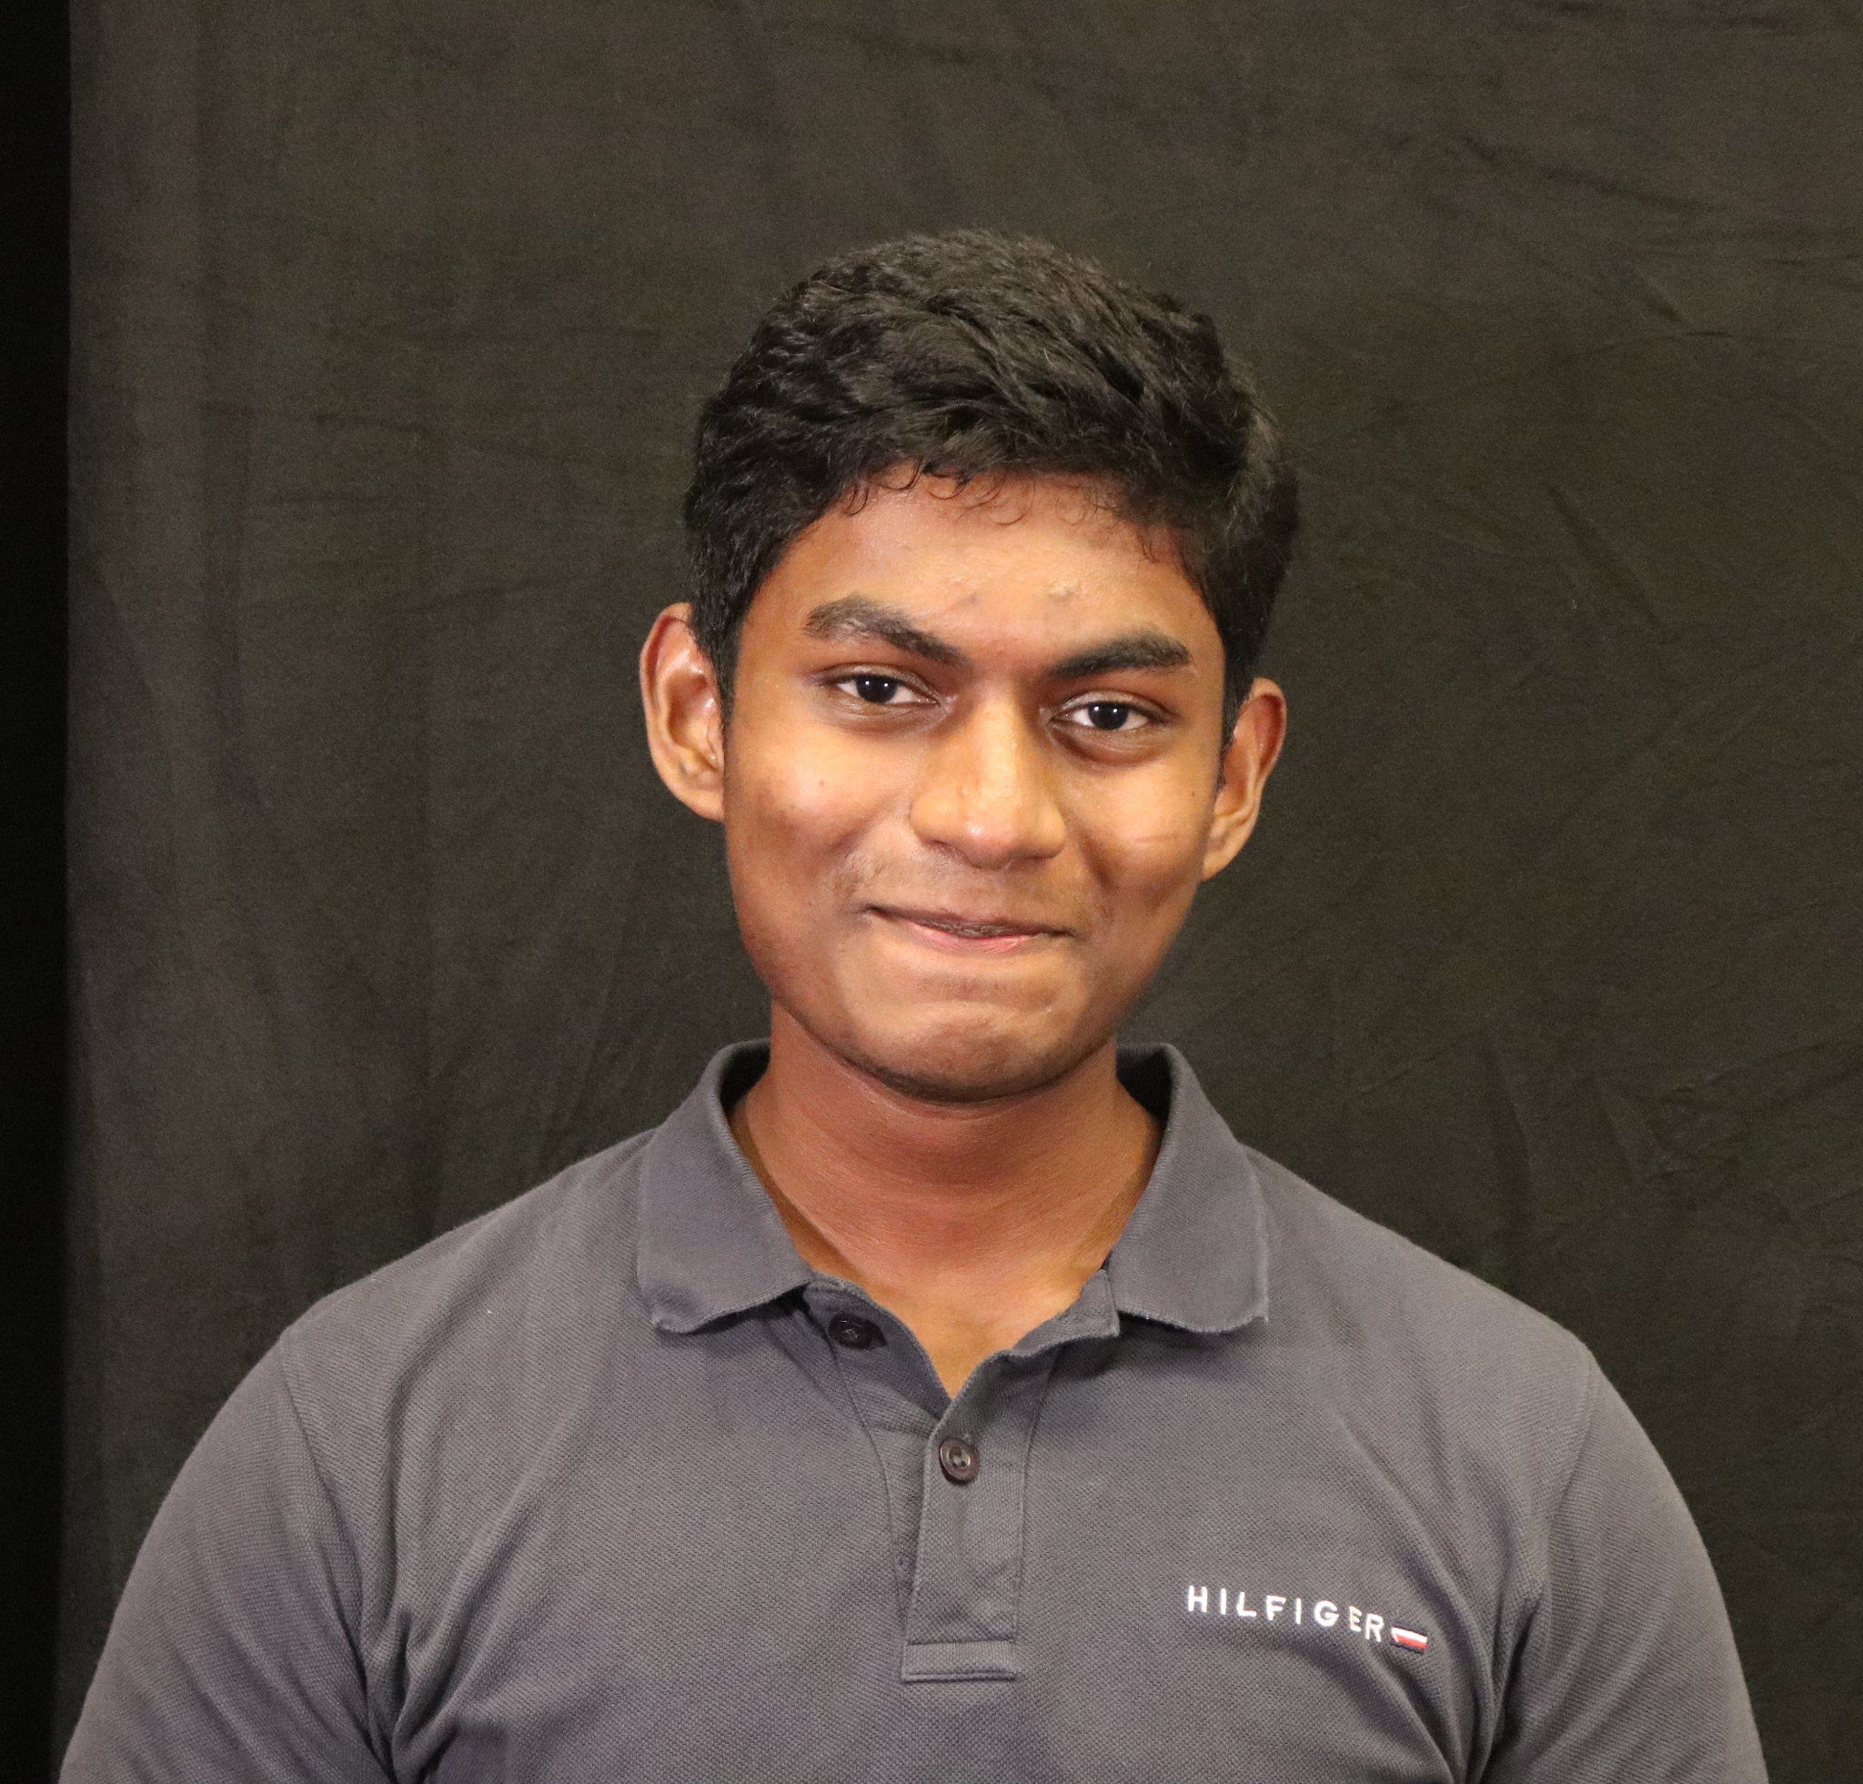

ECE 477 FINAL REVIEW: TEAM #
Jack Gardel
Team Leader
Tyson Kline
Systems Engineer
Andy Helton
Hardware Engineer
Bazim Azeem
Software Engineer
ECE477 Final REVIEW:
TEAM 8 - Engineer’s Chess

Slide 2
OUTLINE
Project Overview
Block Diagram
Design Challenges
Individual Contributions
Project Video Demonstration
Questions

Slide 3
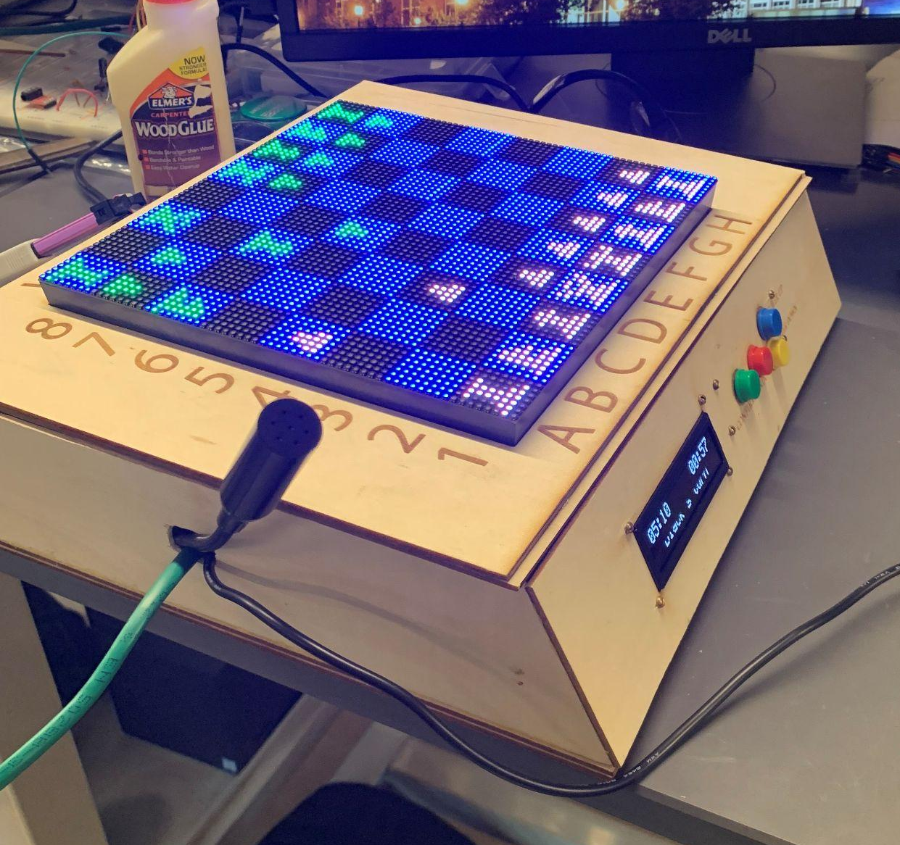
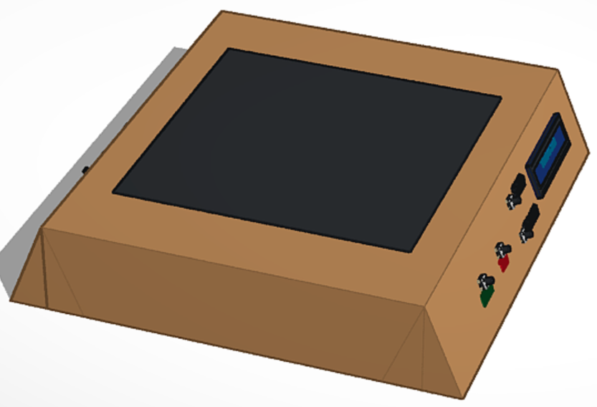
PROJECT OVERVIEW
A voice-activated chess board
Displays board on LED matrix
Receives voice input and processes into chess move
Shows feedback and timers on secondary displays
Notes:
Bazim

Slide 4
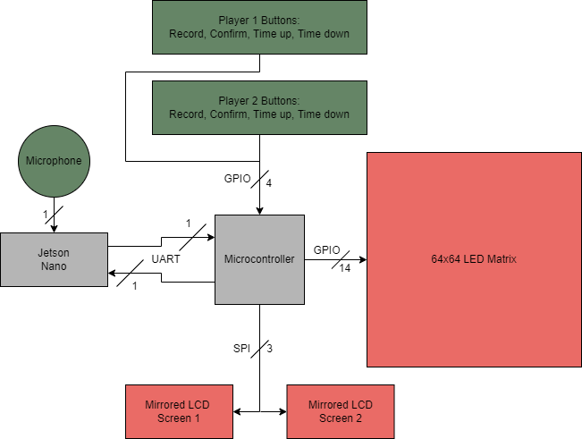
BLOCK DIAGRAM
INPUTS
OUTPUTS
PROCESSING

Slide 5
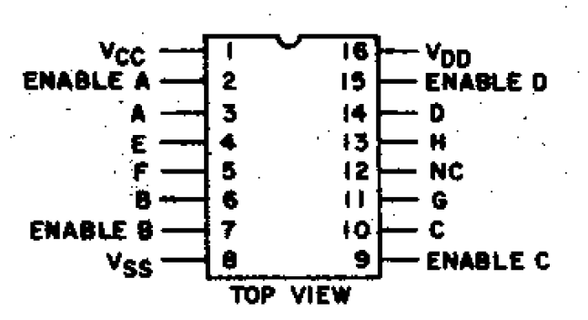
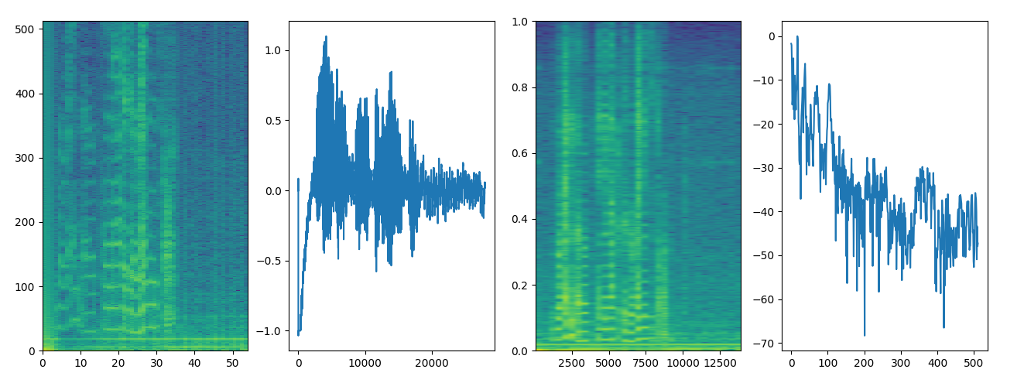
DESIGN CHALLENGES
Needed to create an interface between 3.3V microcontroller GPIO pins and 5V LED Matrix inputs
Shaky display signal due to improper soldering and interaction with analog circuit
Game logic on jetson nano
APIs and Protocols
Voice Recognition

Slide 6
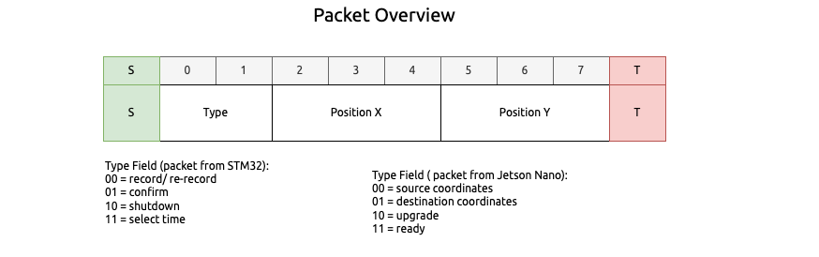
INDIVIDUAL CONTRIBUTIONS
Jack Gardel
Searched for and integrated a voice recognition algorithm
Involved a case study of building a primitive voice recognition algorithm
Set up the OS for the Jetson Nano and boot sequence to get to the main script
Helped debug the design for the PCB and made the side-mounted PCBs
Designed a protocol for communication between the Jetson Nano and STM32
Looked into interfacing with an offboard ADC and adding digital low-pass filters

Slide 7
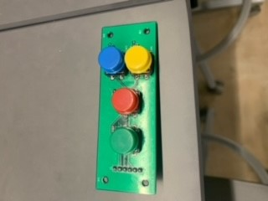
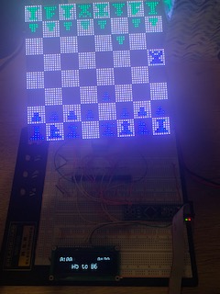
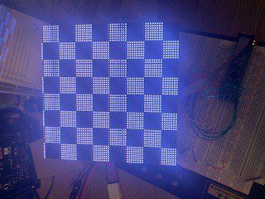
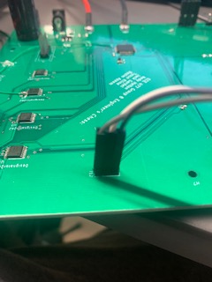
INDIVIDUAL CONTRIBUTIONS
Tyson Kline
Designed and programmed the interface with the LED matrix
Created the initial breadboard prototype
Assembled and debugged the PCB

Slide 8
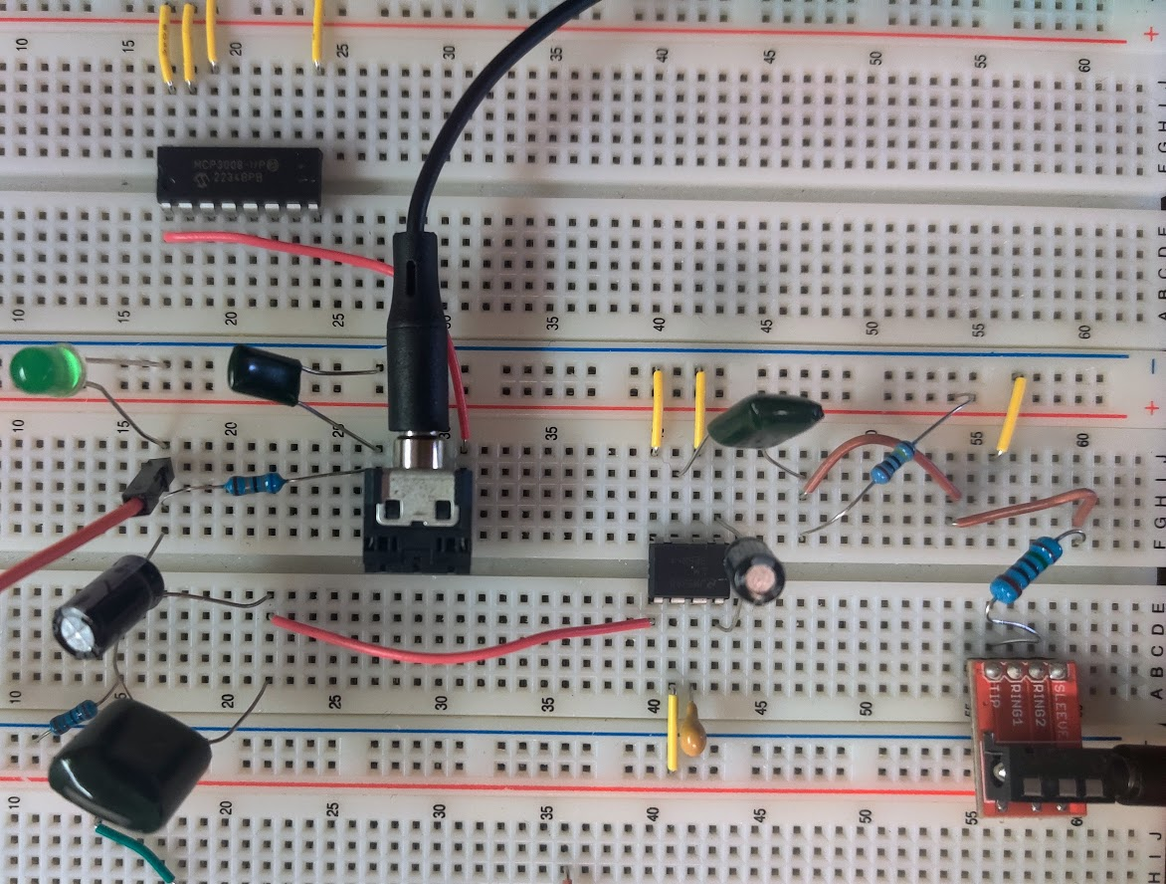
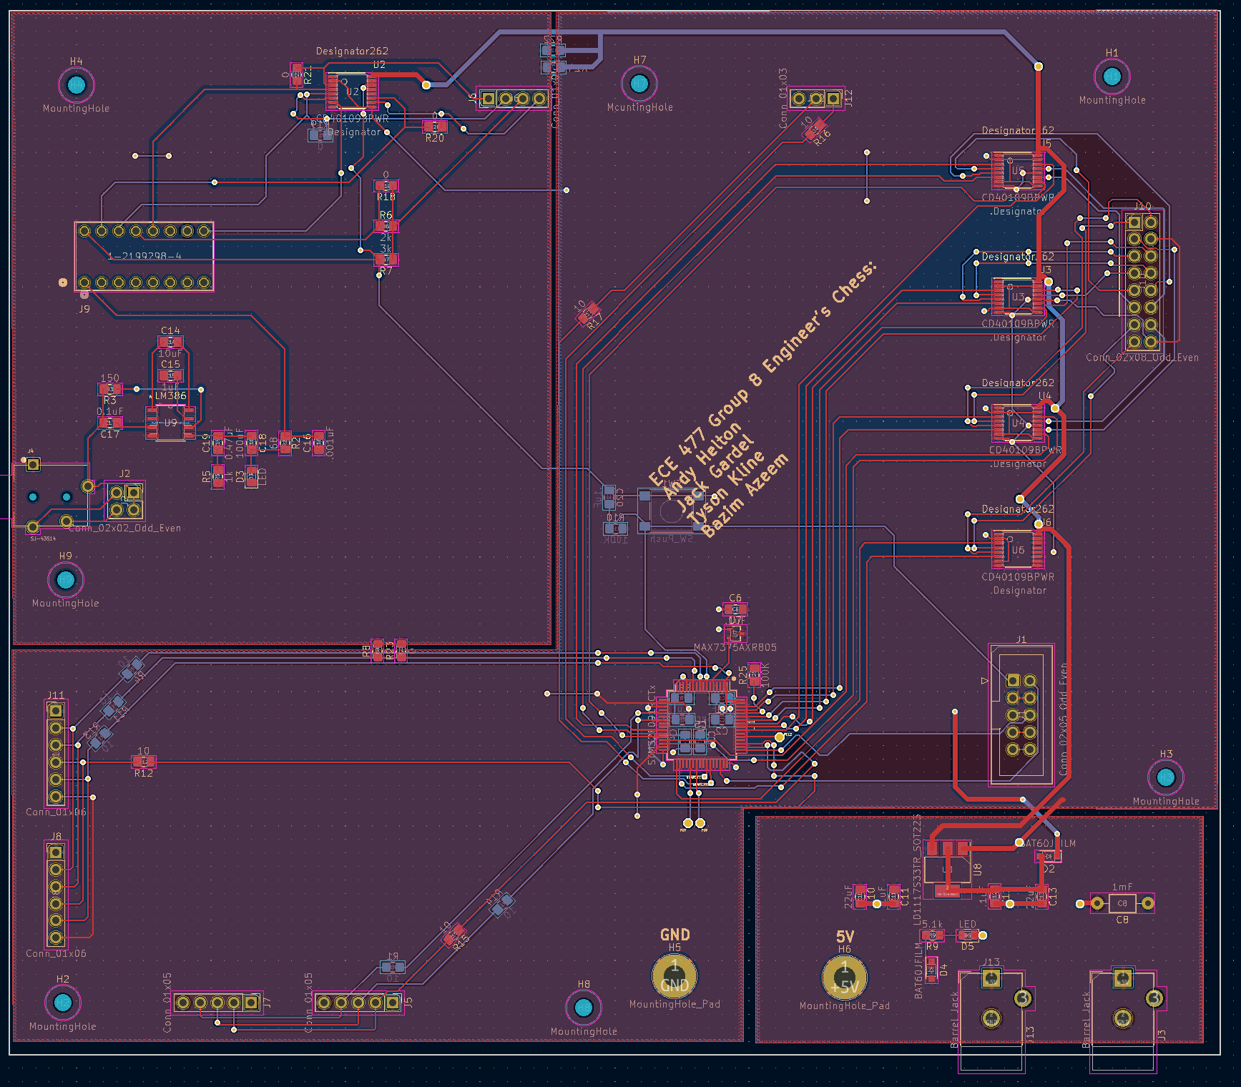
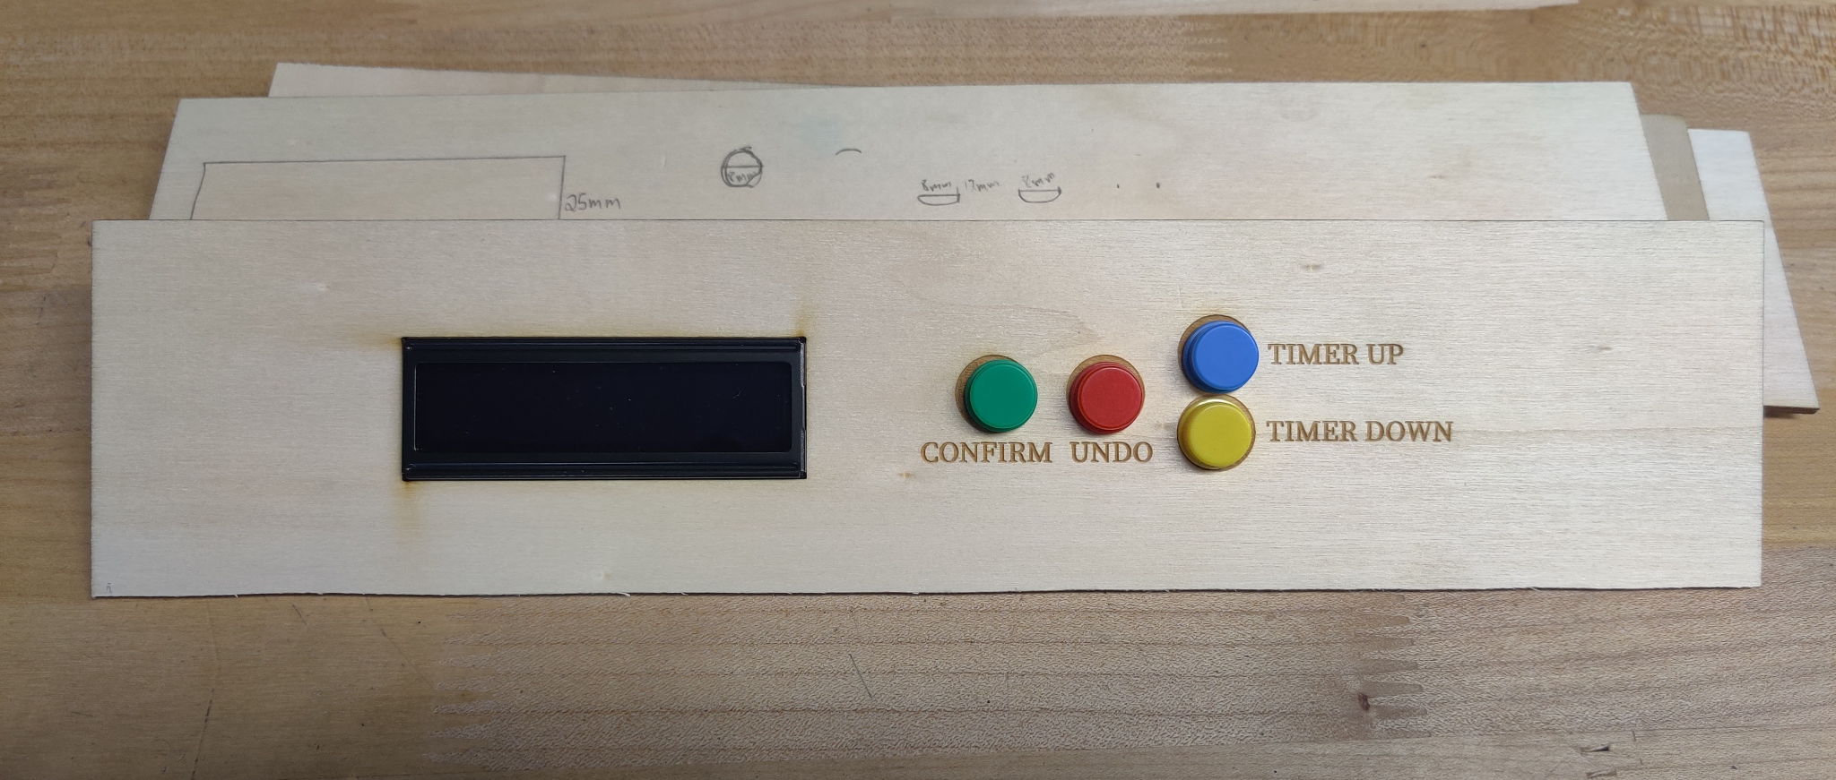
INDIVIDUAL CONTRIBUTIONS
Andy Helton
Designed the stretch goal analog circuit on breadboard
Designed the schematics and implemented the PCB design on KiCad
Constructed the physical components of the chessboard

Slide 9
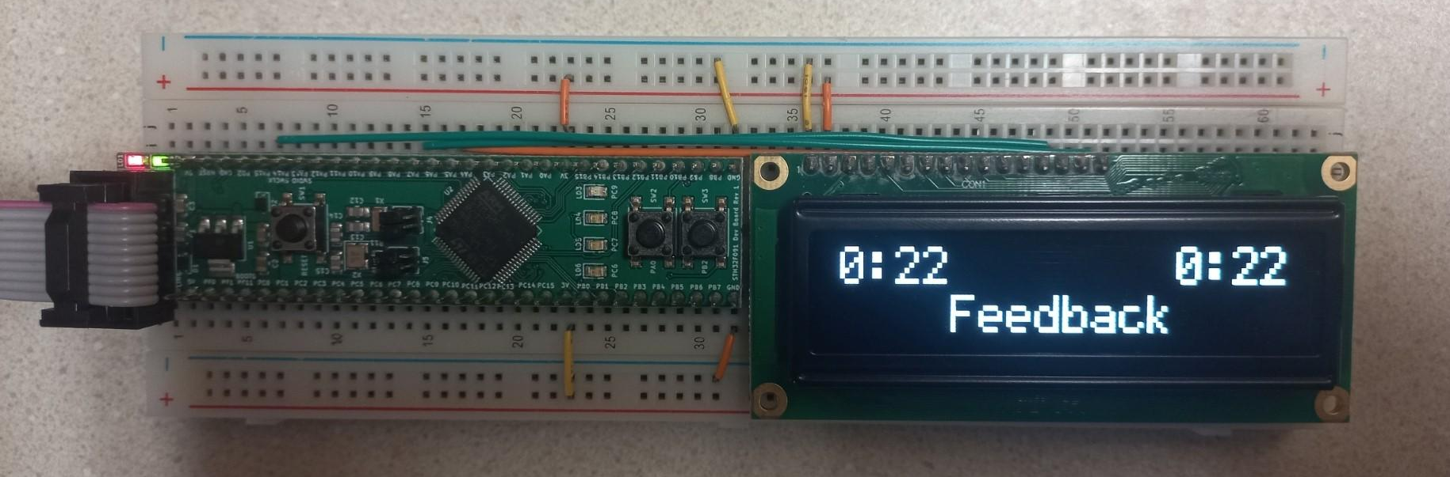
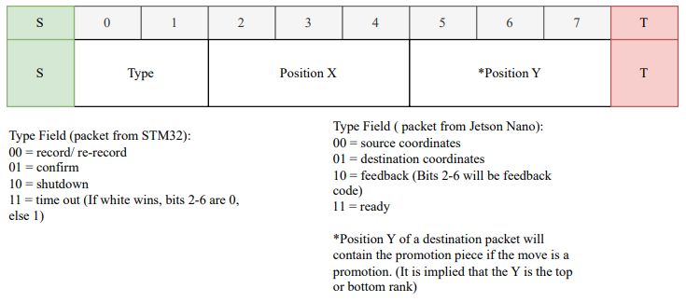
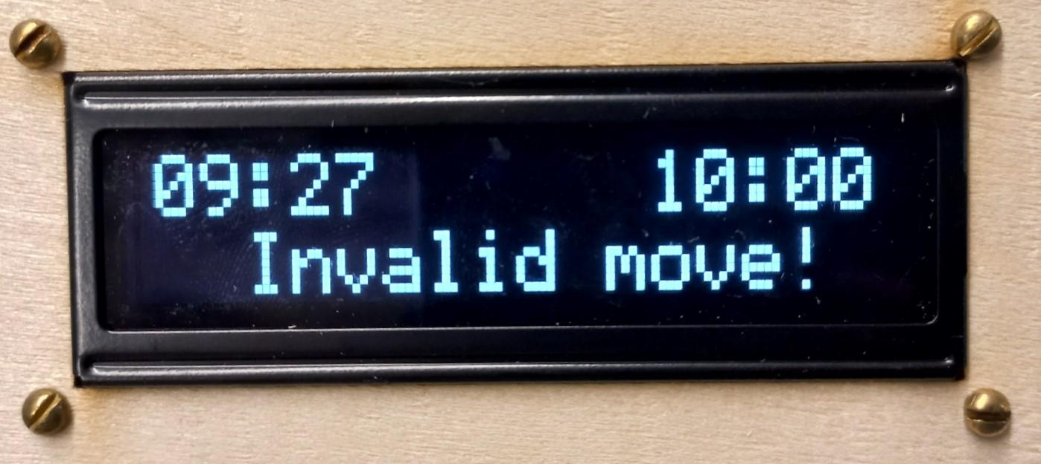
INDIVIDUAL CONTRIBUTIONS
Bazim Azeem
Interfacing with feedback displays
Game logic
Implementing protocol in game
Creating game states

Slide 10
PROJECT DEMONSTRATION
(Software): An ability to pass microphone data stored on the Jetson Nano to a speech recognition algorithm.
(Software): An ability to store and modify data within the microcontroller related to game state to efficiently interface with the game logic.
(Hardware): An ability to interface with an OLED feedback display over SPI with the microcontroller.
(Hardware): An ability to interface with a 64x64 LED matrix using a GPIO bit-banging protocol to communicate real-time game state.
(Hardware): An ability to communicate player commands and Jetson Nano control commands between the microcontroller and Jetson Nano using UART.

Slide 11
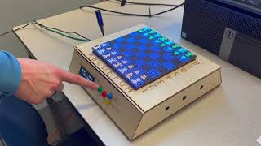

Slide 12
Questions?

